Slide 1


Shock Effects and Mineral Assemblages in the Genomict Eucrite Northwest Africa 8677
Madeline Marquardt
Arizona State University
Arizona Space Grant Symposium
Tempe, AZ
Mentor: Tom Sharp

Slide 2
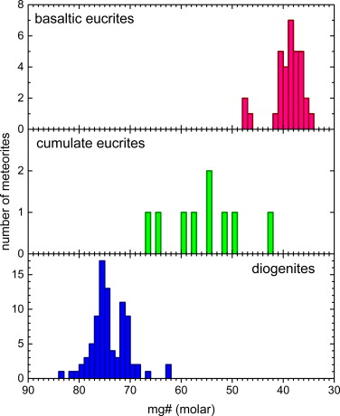
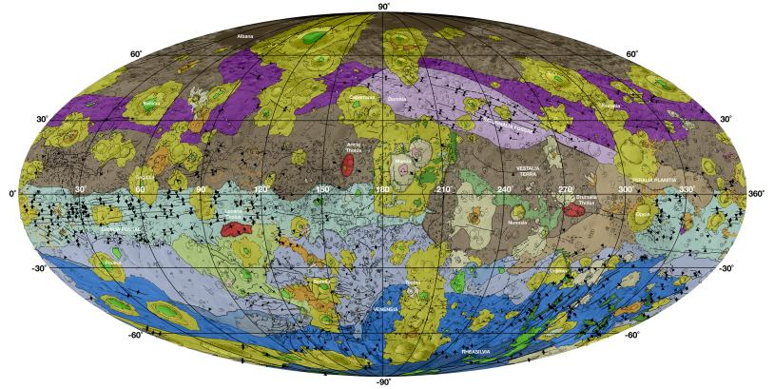
Howardite-Eucrite-Diogenites (HEDs)
Largest group of achondritic meteorites thought to originate from the differentiated asteroid Vesta
These meteorites record the geologic and impact history of the parent body
Howardites are a mix of eucrites and diogenites – demonstrating the active regolith gardening occurring on the surface
JPL Photojournal
Mittlefehldt 2015

Slide 3
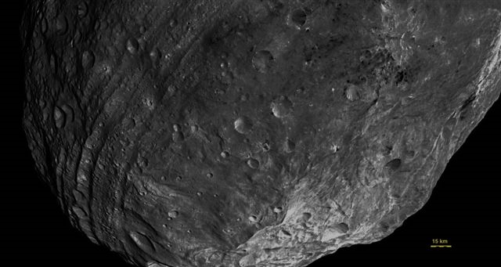
Motivation
The surface of Vesta is highly impacted, yet it is still one of the only intact, differentiated asteroids.
Eucrites are analogous to terrestrial basalts.
HEDs record early solar system impact history between 3.4-4.1 Ga and 4.48 Ga.

Slide 4
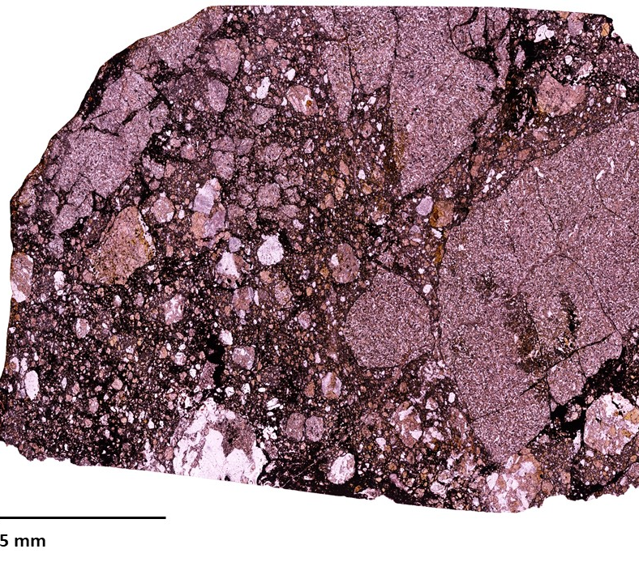
Northwest Africa (NWA) 8677
NWA 8677 is a genomict eucrite with 3 lithologies that are texturally different, but compositionally similar
Abundant shock melt veins and pockets as well as interstitial shock melt between breccia
Determine the impact history of NWA 8677 through a petrographic analysis and determining the shock stage experienced by different lithologies.

Slide 5
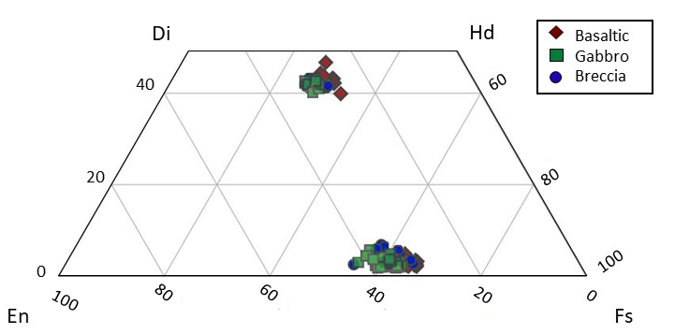
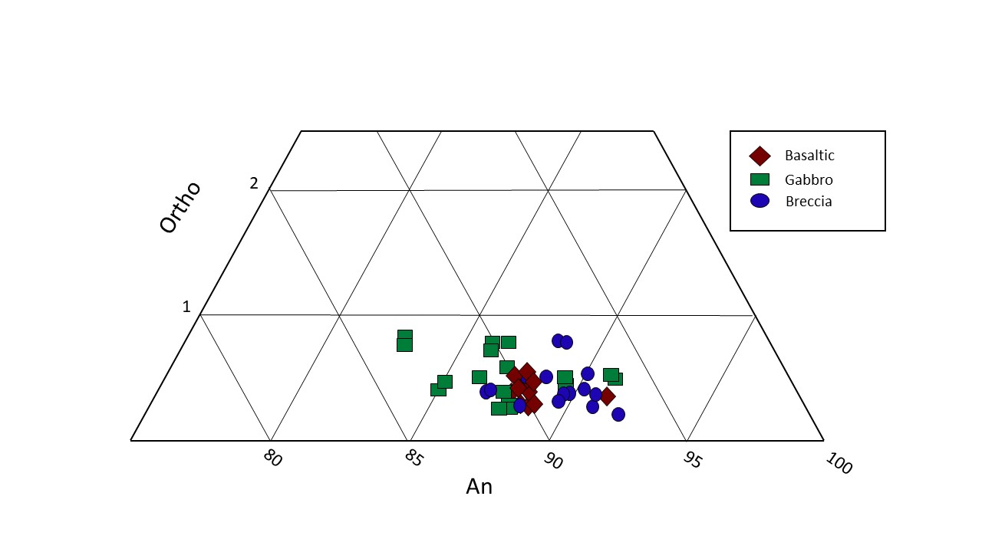
Petrography
Pyroxene Quadrilateral
Plagioclase Ternary
Enstatite compositions are tightly clustered in basalt (En₃₄₋₃₆), broader range in gabbro and breccia (En₃₁₋₄₂)
Typical range of plagioclase for eucrites is An₈₄₋₉₃
Atypical abundance in K₂O – normally ≤0.2 wt% - here K₂O ranges from 0.3 – 0.8 wt%
Notes:
Explain what the quadrilateral is – Say full name for end members – CPX and OPX
Not enough compositional variance to be considered polymict.

Slide 6
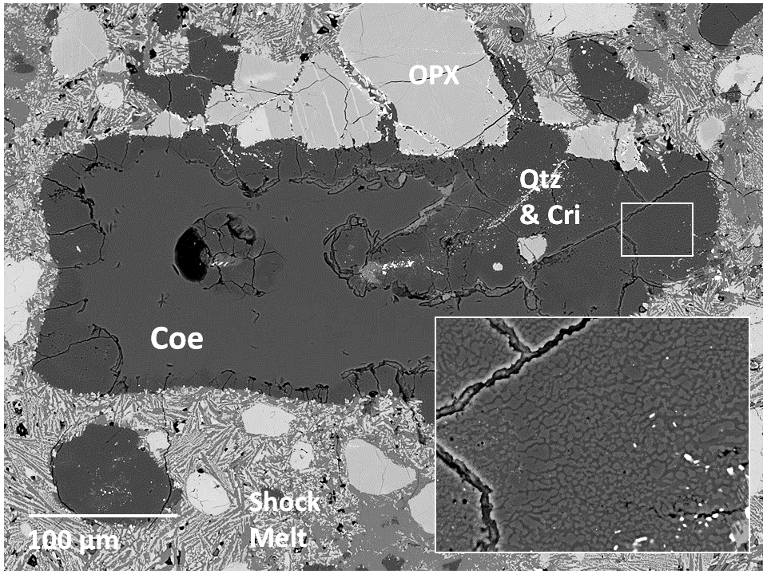
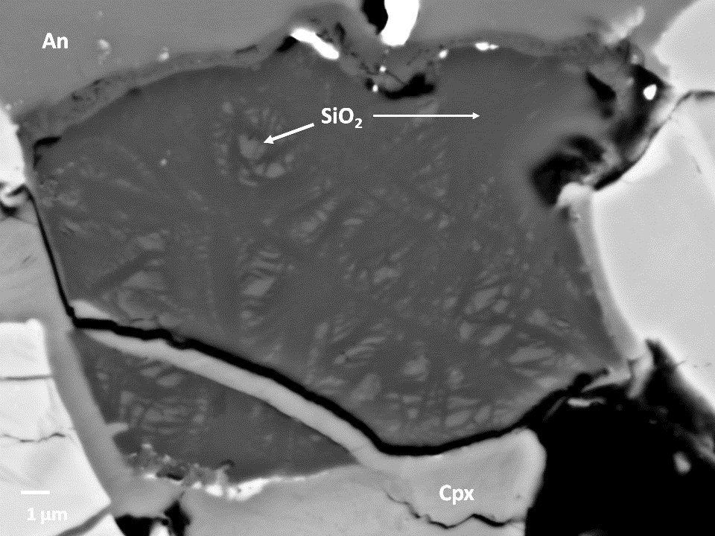
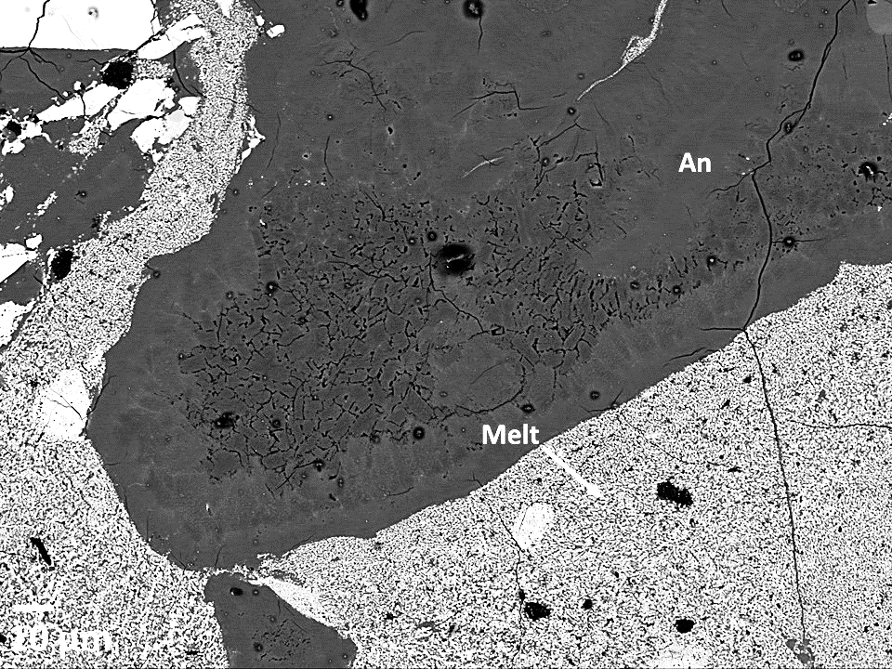
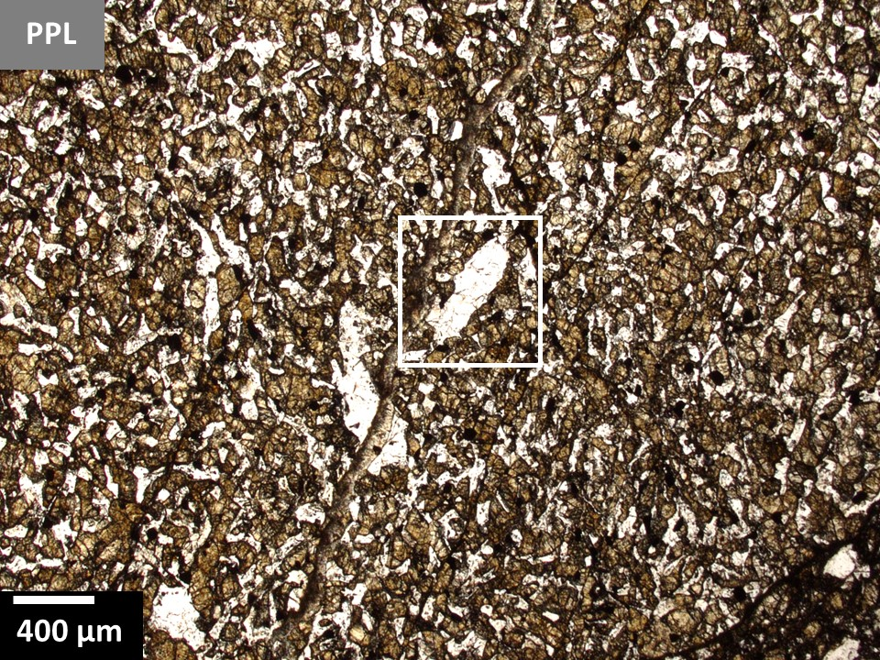
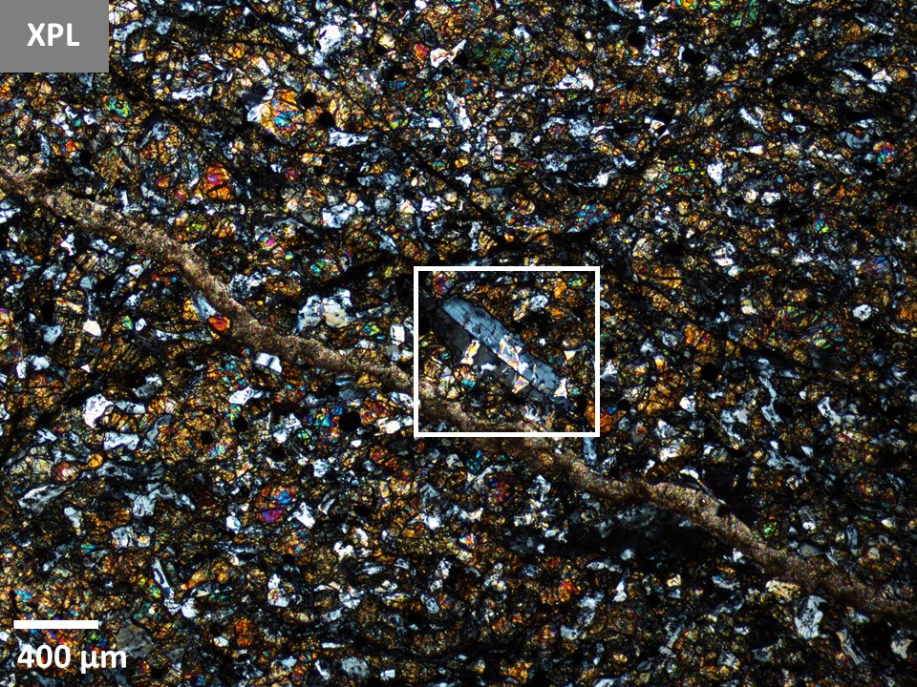
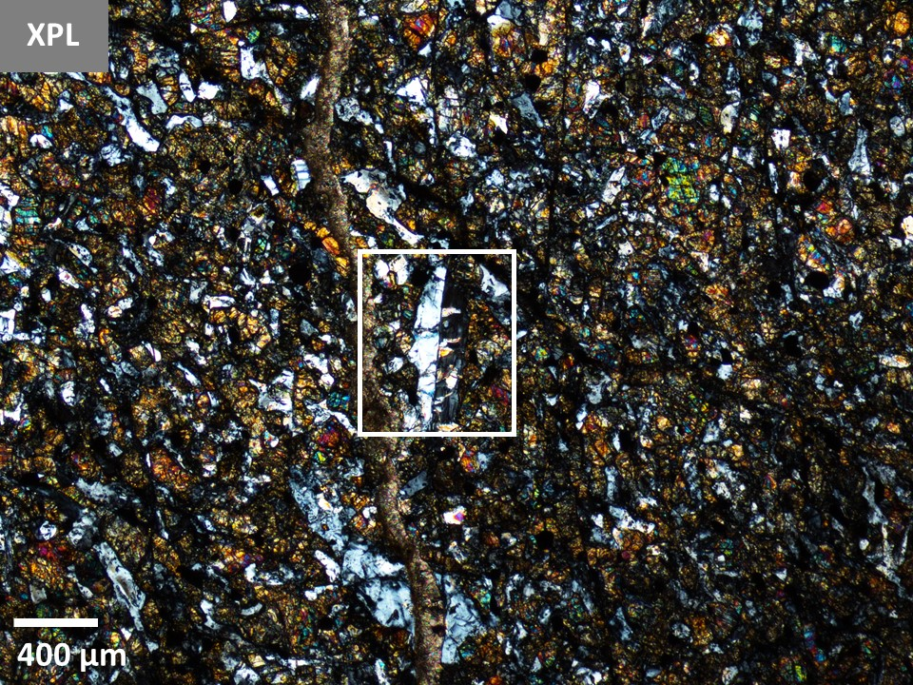
Shock Effects
Strong shock effects are preserved in gabbro
High-pressure polymorph of silica and recrystallized plagioclase
Weakly shocked basalt
Retain crystalline plagioclase
a
b
c
d
e
f
Notes:
Preservation of large (~250 μm) silica grain with core of high-pressure polymorph coesite (a)
Brighter domains of high-pressure recrystallization (b)
Recrystallized plagioclase surrounded by shock melt (c)
Twinned feldspar in basalt (d,e,f)

Slide 7
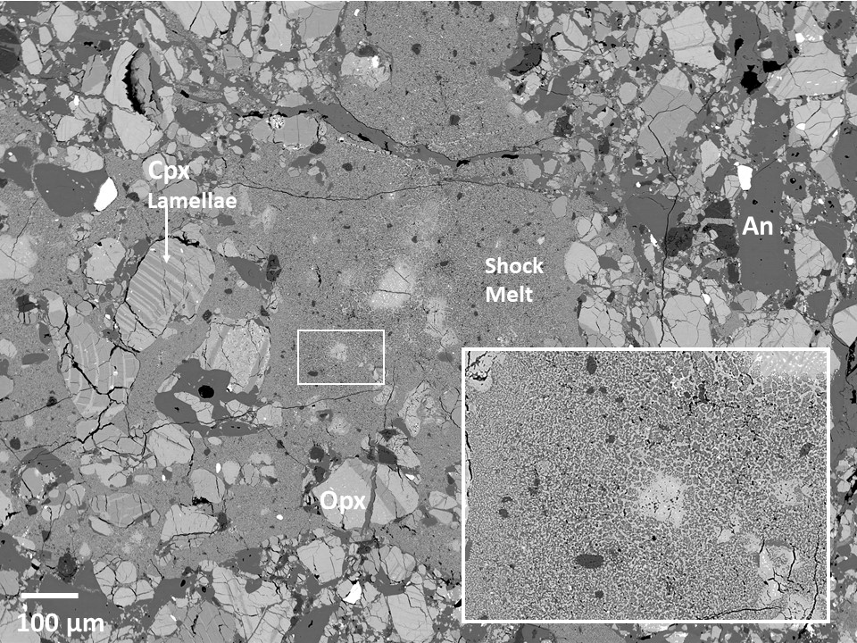
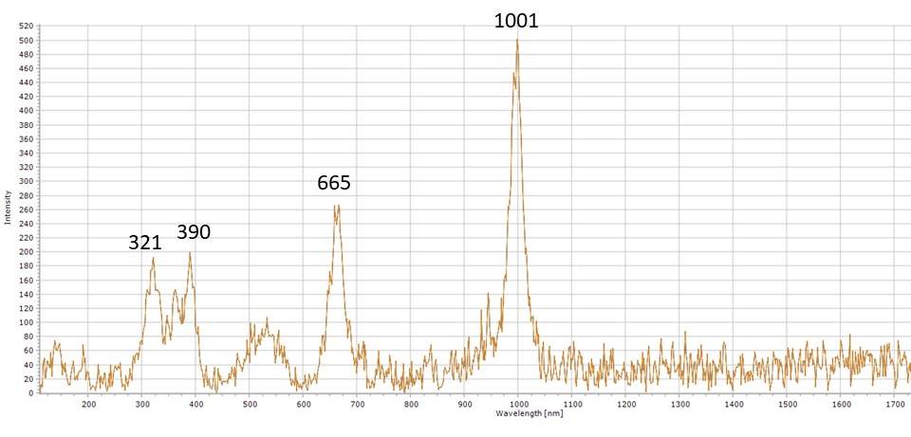
Shock Melt
The shock veins have a low-pressure bearing mineral assemblage of plagioclase and pyroxene (spectrum)
This indicates the shock melt crystallized after pressure release
High post-shock temperatures back transformed maskelynite, but not coesite

Slide 8
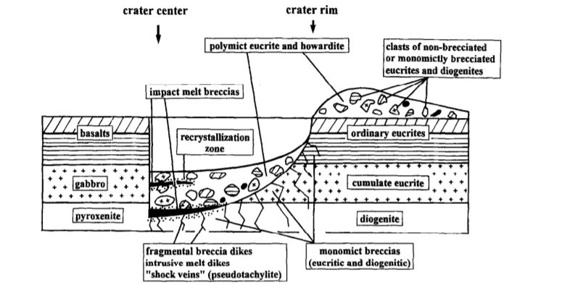
What Happened? Possible Explanation – Timeline
Initial impact that strongly shocked gabbro and brecciation– evidence in form of high pressure minerals
Mixing of more weakly shocked basalt in the regolith
Second impact that generated extensive shock melting and crystallization of shock melt at low pressure
High post-shock temperatures that back transformed maskelynite and partially transform coesite
Metzler et al. 1995

Slide 9
Acknowledgements
Tom Sharp (Mentor) and Crystyl Fudge (Graduate student)
Tony Irving (University of Washington)
School of Earth and Space Exploration (ASU)
Data were acquired within the Eyring Materials Center at ASU.
Funding for this project was provided by NASA/ASU SpaceGrant.
NASA Grant 80NSSC18K0591to Tom Sharp.
Notes:
Thanks to Tom and Crystyl for helping
Tony for the sample
Funded by space grant and NASA grant

Slide 10
Questions?

